Slide 1
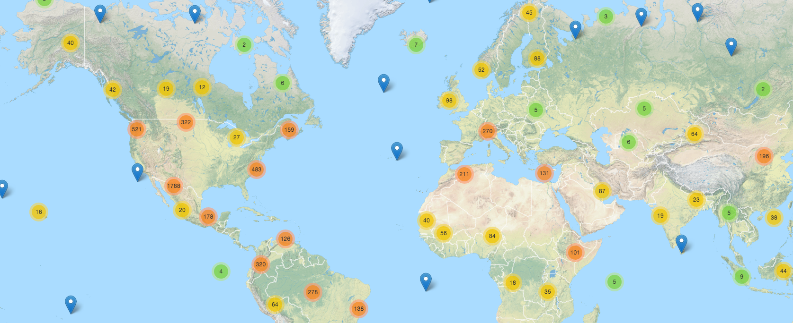


Leveraging the Where in Scholarly Literature
Enabling geographic-based knowledge discovery
Jason Karl, Ph.D.
USDA-ARS Jornada Experimental Range
Notes:
Good afternoon. I’m Jason Karl. I’m a research scientist with the ARS Jornada Experimental Range. I’m going to talk today about how focusing more on the “where” of scholarly research can help us better find and use the “what” that’s in those sources.

Slide 2
What happens if you want to search for research:
from a specific place?
from a similar area?
based on some other criteria?
Climatic, demographic, economic
Notes:
Search technologies have advanced tremendously since I was a grad student. We used to have to go up to the library and pour over reference index books to find literature on what we wanted. Then these started coming on floppy disks, then CDs, finally the internet. But some aspects of literature searching haven’t really changed that much – we’re still primarily searching by topics and keywords.
What happens if you want to find articles for a specific place?
Or from an area that’s similar to one that you’re considering?
How do you know if a study that was done in a different area is relevant to your research?
What if you wanted to search not off of place, per se, but some other criteria like climate, population, or economic attribute?

Slide 3
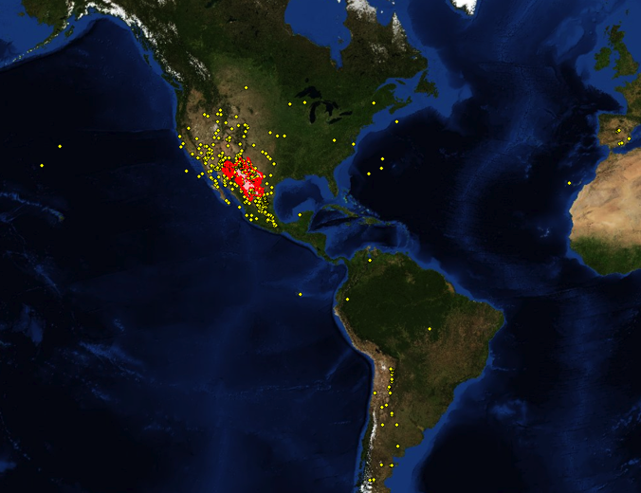
Example: Chihuahuan Desert Ecology Studies
Chihuahuan Desert
Studies from “Chihuahuan Desert” literature search
Web of Knowledge Search for “Chihuahuan Desert” in ecology journals. 784 articles could be mapped
282 (36%) actually in Chihuahan Desert
Doesn’t represent myriad articles in the area not using place name term
Notes:
Here is a real example of this for a Web of Knowledge literature search we did for ecological studies in the Chihuahuan Desert. My search here returned a little more than 1000 articles with the phrase Chihuahuan Desert in the title, keywords, or abstract. We looked at each of these articles and geotagged the ones we could based on where the study actually occurred. We were able to map almost 800 of the articles, whichi is a pretty good return. The map here clearly shows the result – only 36% of the studies we found actually occurred within the Chihuahuan Desert. But what this map doesn’t represent is all of those studies that occurred within that ecoregion but didn’t use those two geographic keywords.

Slide 4
Geographic-based literature searching
Results
Theme
Place name
General context
Semantic search
Relevant to theme
Relevant by similar context
Relevant to location
Question: e.g., soil erosion in North American Southwest
Specific location
Similar areas
Geo-semantic search
Source: Karl et al. (2013)
Notes:
So here’s what’s going on with that “Chihuahuan Desert” example:
When you search for scientific literature using most of today’s widely used tools like Web of Knowledge or Google Scholar, you are largely limited to topic and keyword searches and perhaps some general context or location information like place names. From this kind of search you will get results that are relevant to your topic but only a portion of those results may be relevant to your particular location.
With the ability to add location information explicitly, though, allows you to hone your results down to a specific area. Additionally, explicit location-based searching also lets you query other spatial attributes like soils or climate to search for literature results that may not come from your particular area but may still be relevant because of their ecological context.

Slide 5
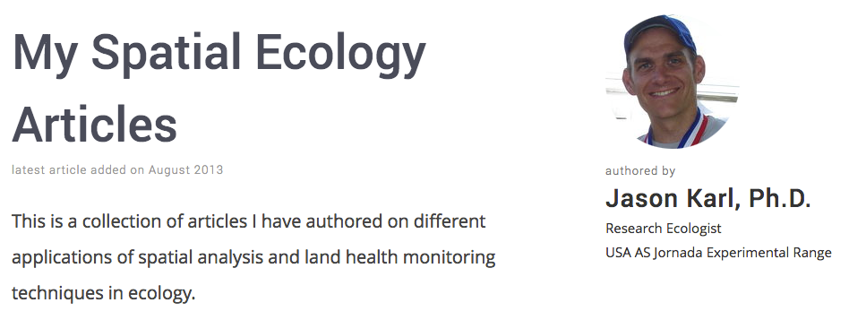
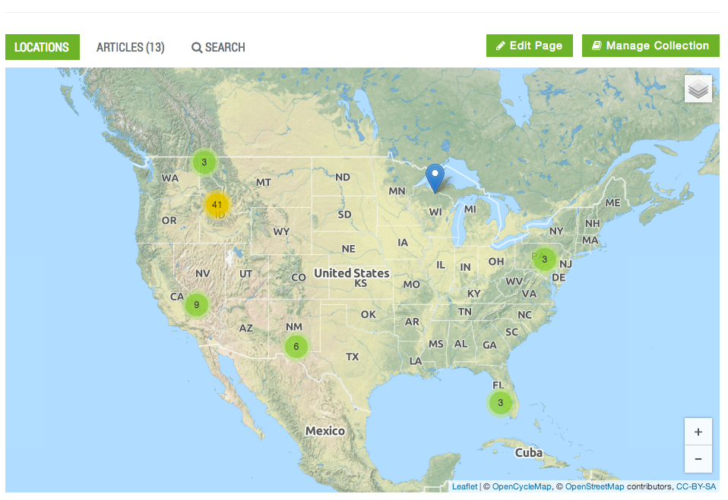
1. Searching by location 2. Study locations, not author affiliations!
Notes:
Two important clarifications to make here:
I’m talking about the ability to search for literature (i.e., knowledge) geographically. There are several efforts underway at delivering interactive maps within online articles (e.g., Elsevier’s Article of the Future, Pensoft). I have an article in press with an Elsevier Journal that I was able to supply a Google Earth file for – that’s cool, but it doesn’t enable me to search for the article geographically. There are also data repository sites like Pangea that give map interfaces for finding data associated with published articles. These efforts are also cool, but often I don’t want the data as much as I want the knowledge derived from those data.
I’m talking about mapping and searching by the actual locations where the study was conducted, not the location of an author’s affiliation. Take a look at this example here for some of my articles. Knowing that I’m based out of southern New Mexico doesn’t do you a lot of good in finding my studies which are all over the US.

Slide 6
Opportunity: leverage location information in studies
Location Reporting in Natural Resource Studies
Place Name Reported (32%)
Geographic Coordinate System (90%)
Coordinates Reported (58%)
Other Coordinate System (10%)
No Location (10%)
Data from JournalMap database of > 6,000 articles
Notes:
In scientific literature on natural resources, the majority of studies report some kind of location where the study was conducted. Those papers that don’t report a location are generally review papers, syntheses, opinions, or conceptual papers. Of the studies reporting a location, about 60% use some kind of coordinate in that study area description – either for a single point or to define a bounding box. Of the coordinates reported, about 90% are some format of a geographic latitude and longitude (i.e., degrees, minutes, seconds or decimal degrees). This represents a huge opportunity in improving knowledge discovery through scientific literature searching if we can rescue this information that’s locked away in the text of the studies.

Slide 7
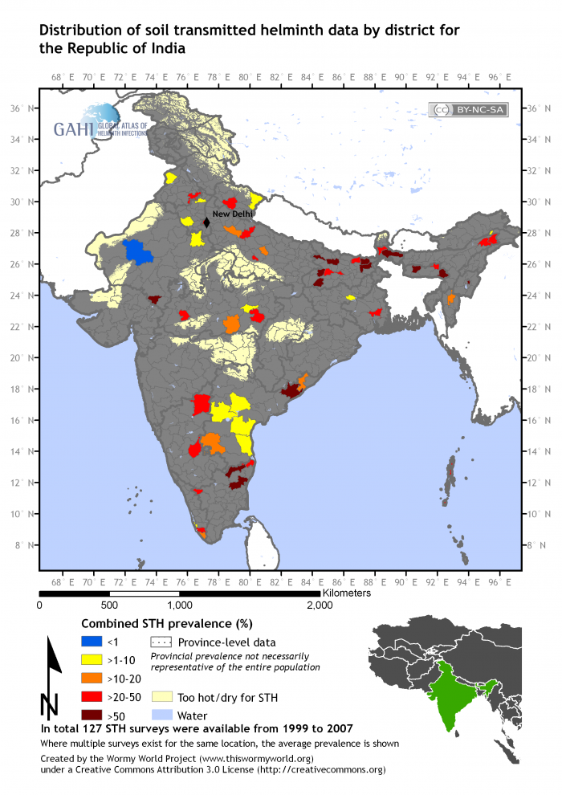
The geographic bibliography
Show the distribution of knowledge
Infectious disease
Species distributions
Climate change
Land use science
Soils, agriculture
Notes:
One of the main ways in which location information in studies is being leveraged is with the “georeferenced bibliography” – essentially a collection of literature related to a specific topic (or area) that has been geotagged. There are a number of examples of these from all sorts of different fields (like this example of neglected tropical diseases in India). For the most part these are high-investment exercises that require a lot of effort to manually identify and geotag the literature. As a result we’ve found that they’re difficult to sustain.

Slide 8
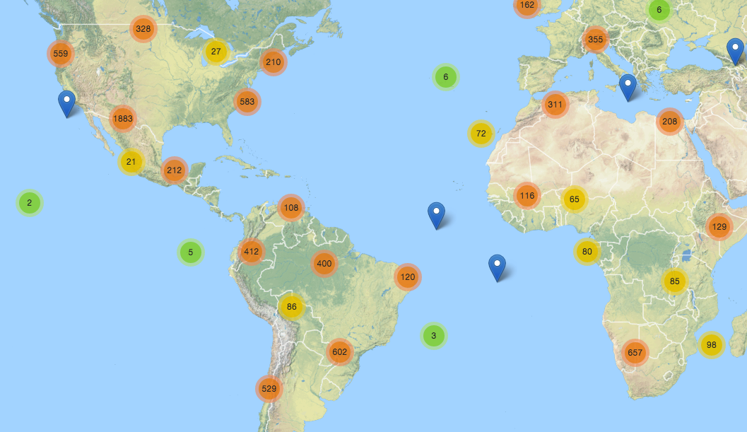
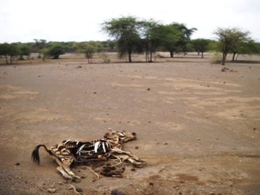
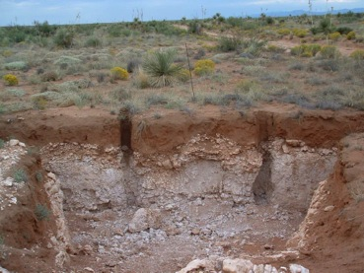
Knowledge Discovery & Transfer
Transfer of knowledge to environmentally-similar areas
Based on attributes like soils and climate
Knowledge Transfer
(Similar Climate & Soils)
Notes:
But the georeferenced bibliography doesn’t help us much if we’re working in an understudied area. In this case, we’re after knowledge transfer, but in order for knowledge to be transferable, it must have come from someplace with a similar context. For example, research in southern New Mexico into land management practices to minimize erosion and prevent drastic state changes may be applicable to areas with similar soils and climate in southern Africa. For this to work, though, we not only need to be able to search for literature geographically, but we also need to be able to define and filter for location similarity based on other attributes (like soil properties and climate variables in order to find knowledge from research rich areas and apply it to research poor ones for things like sustainable agriculture).

Slide 9
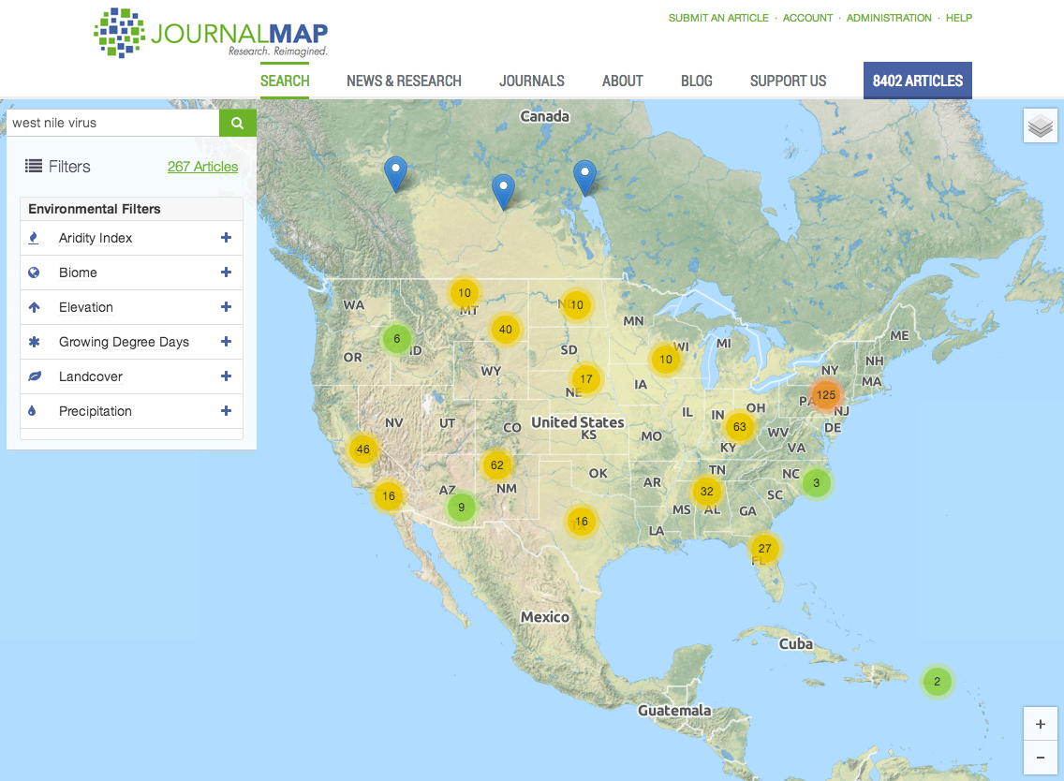
Geographic Literature Search
www.journalmap.org
Notes:
That’s what we were after in creating JournalMap. A robust geographic search engine needs to be built off of articles that are geotagged with latitude/longitude coordinates or mapped lines or polygons, not place names. This gets around the “Chihuahuan Desert” problem I showed earlier. It also enables complex spatial queries and similarity-based searching.

Slide 10
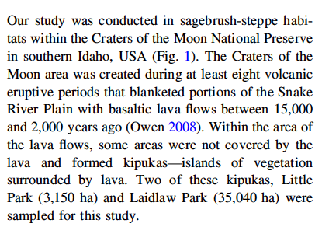
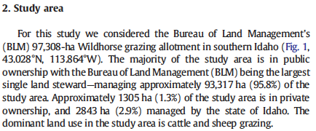
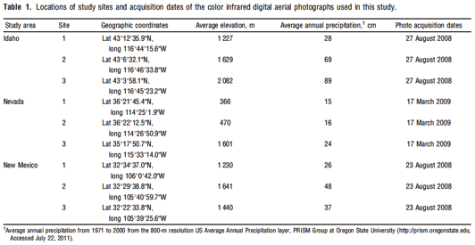
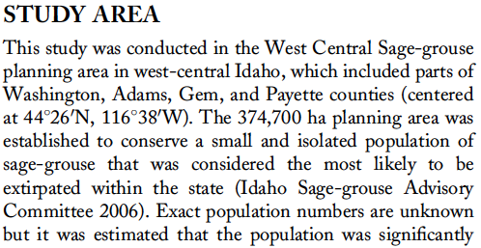
Challenge: Extracting location information from published studies
90%
of ecological studies report a study location, but use countless ways to do it
58%
of ecological studies report geographic coordinates for their study area
Notes:
The challenge is how to actually find and extract the location information from published studies. Statistics of location reporting vary by discipline, but for the ecological literature that I’m most familiar with, most studies report a study area location, and almost 2/3 of those give coordinate values.
But here are some examples from published papers that illustrate the complexity of the problem. I should mention that I’m not skewering any other authors here – these examples are all from papers that I’ve published. You can see that just in these four examples there is a diversity of different ways to report study locations, from place names to coordinates in text to tables. So the location information is there in published studies, but getting it out isn’t trivial.

Slide 11
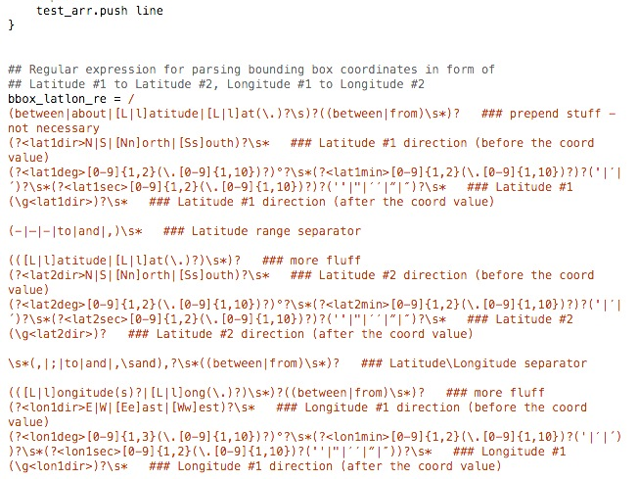
Article Geotagging
Locations can be extracted from article text
Pattern matching for coordinate values
JournalMap >80 coordinate formats
Place-name recognition is challenging
Studies have many irrelevant place names
Problem: errors in reported locations
JournalMap ~ 2 to 5% error rate found
Shapiro & Baldi (2012): 20% of the time coordinates and place name didn’t match
Notes:
So how do we go about geotagging articles? We’ve had a lot of luck with JournalMap in developing pattern matching algorithms to detect and extract coordinates if they’re present in an article. Place-name recognition is much more challenging, but we’re actively researching this. The best we can do now is a semi-automated approach to geotagging where our parsing engine automatically geotags articles with coordinates and then somebody goes through an manually geotags the remainder using some tools/workflows that make the process pretty fast.
There is a potential problem with geotagging already published articles, though. Sometimes the location information that was published isn’t correct. With JournalMap we’re finding about 2 to 5% of articles have some sort of obvious problem with the coordinates that are reported (e.g., latitude values greater than 90º). But these are only the obvious errors that we’re catching. One study that looked into it reported that about 20% of studies reported coordinates that did not correspond to the place-name description given in the article.

Slide 12
Getting There… Past & Future
Article
Geotagging
Scholarly Articles Published
Location Reporting Standards
Manual
Semi-automated
Published articles
Future articles
Time
Now
Notes:
Geotagging already published articles is a necessary step in enabling location-based lit searching, but as a tool, we should only be relying on it for capturing past articles. The semi-automated approach I just described works well for recent articles, but the older an article is, the more likely it is that we’ll have to do manual geotagging. The best path forward, though, is to develop and implement some standards for reporting locations and encoding those locations in articles.

Slide 13
Location Reporting Standards
Standardized approaches for reporting study locations
Encourage (require?) better location reporting
Instructions for Authors
Taylor & Francis
Pensoft
Supplemental files
Validate locations at submission
Reduce errors
Encode locations in metadata and XML
Dublin Core
Darwin Core (used by Pensoft)

Slide 14
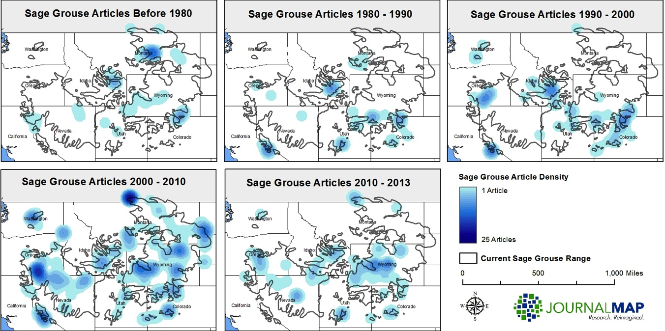
Notes:
If we can achieve a very large (and for some topics comprehensive) set of geotagged articles, it opens up some innovative opportunities for how those articles can be used. For example, having a comprehensive map of studies lets us analyze the distribution of knowledge and identify potential hot spots & cold spots. In this example we did a fairly comprehensive search for Sage Grouse literature and geotagged all the references we could find. Breaking the results out by time period lets see how the knowledge of Sage Grouse evolved over time and identify centers of sage grouse research like eastern Idaho and potential gaps like eastern Nevada. This kind of information could help direct research & inform conservation efforts for the species.

Slide 15
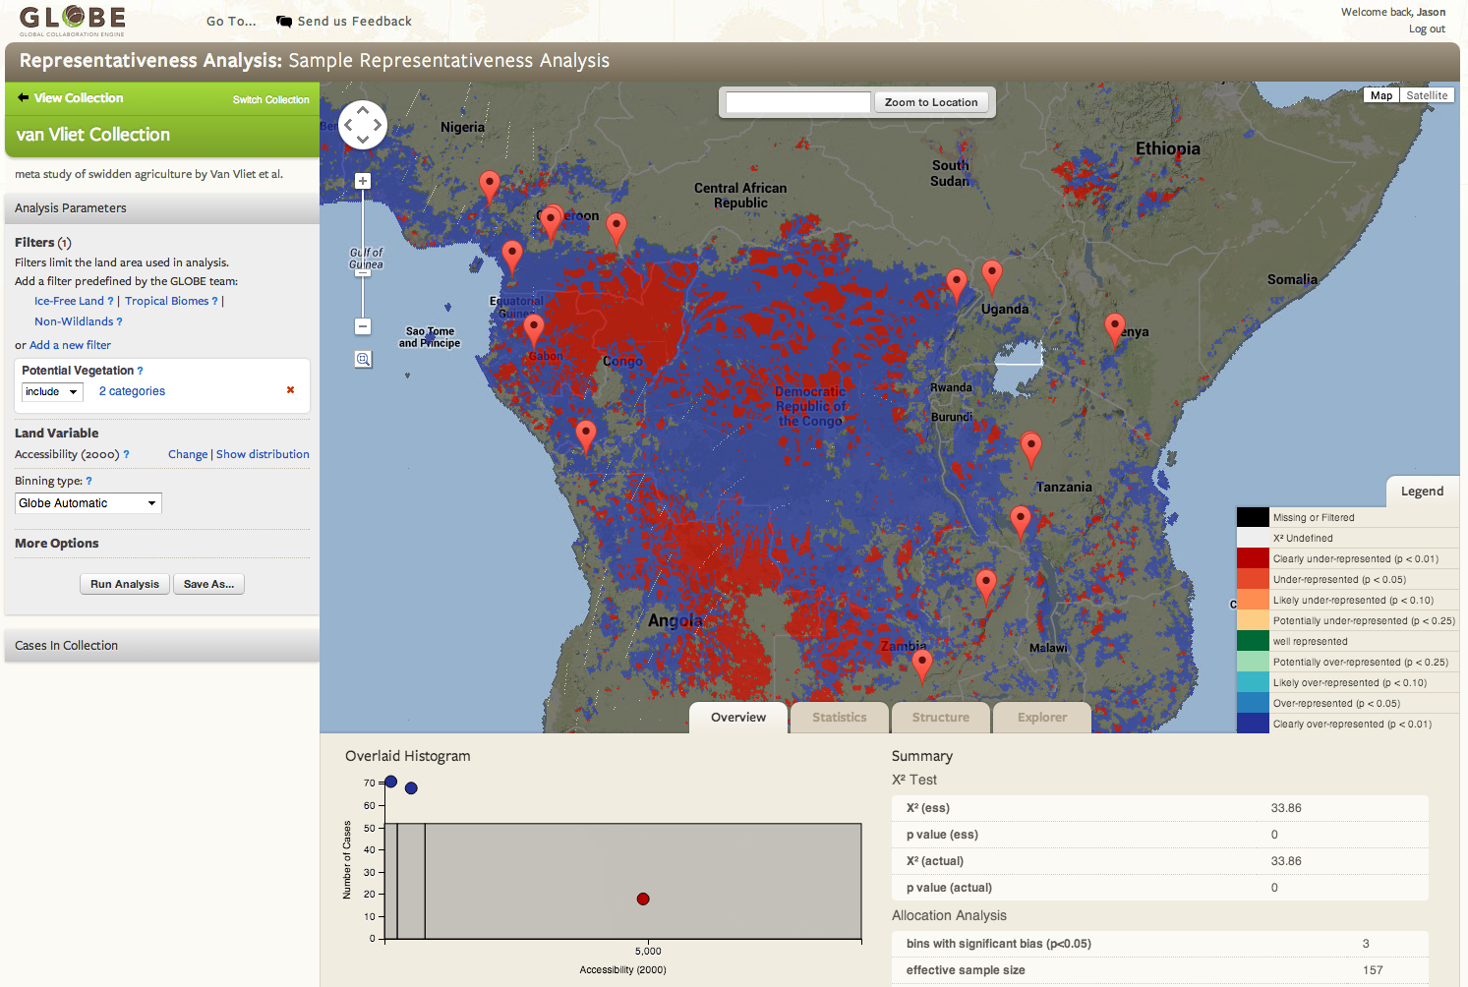
http://globe.umbc.edu
Notes:
Here’s another really cool example of what you can do with geographic-based literature search results. The GLOBE project was designed as an analytical toolset for selecting case study articles that would be good candidates for larger meta-analyses of land use change. In this example, a set of records is analyzed in terms of how well it represents an area when defined by certain environmental parameters (the colored-in areas). Blue means that the studies over-represent this area. Red areas are those that are under-represented in the set of articles. This is just scratching the surface of the kinds of things we can do with geotagged articles and geographic-based literature searching.

Slide 16
Leveraging the Where in Scholarly Literature
Enabling geographic-based knowledge discovery
Jason Karl, Ph.D.
USDA-ARS Jornada Experimental Range
http://www.journalmap.org
Twitter: @JournalMap
Email: jason@journalmap.org Tel: (575)-646-1301
Notes:
As a researcher and author, I see tremendous value in being able to discover and analyze scholarly literature by its location as well as by more traditional keyword and topic searching. I think that we’ll see some breakthroughs in this arena in the coming years as we continue to push article geotagging, location reporting standards, and search tools. I’d love to talk to anybody here about this if you’d like to either learn more or to contribute to our efforts.

